Slide 1
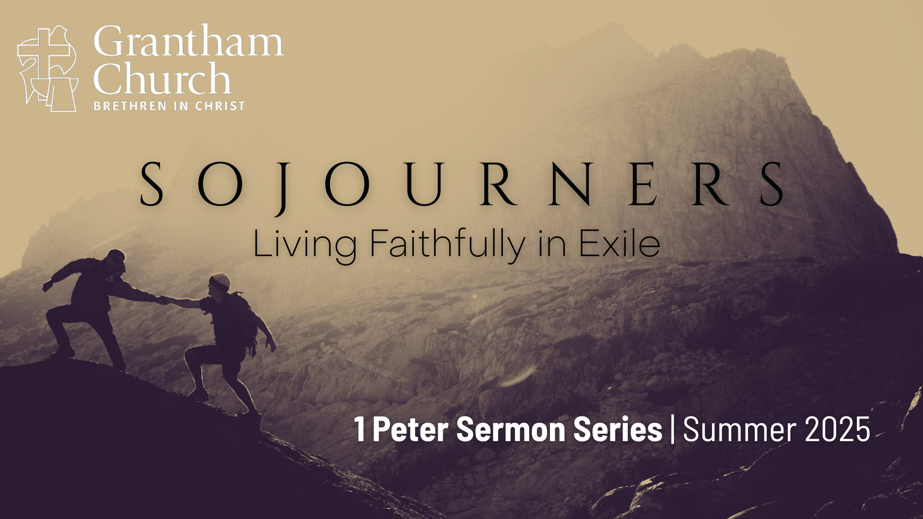
Notes:
We are continuing our journey through 1 Peter in our summer sermon series, Sojourners: Living Faithfully in Exile. In Peter’s first epistle, as well as the rest of the New Testament, followers of Jesus are often referred to as resident aliens, strangers, foreigners, sojourners, and exiles on earth in this present evil age.
For example, at the heart of Peter’s letter are these two verses… NEXT SLIDE]

Slide 2
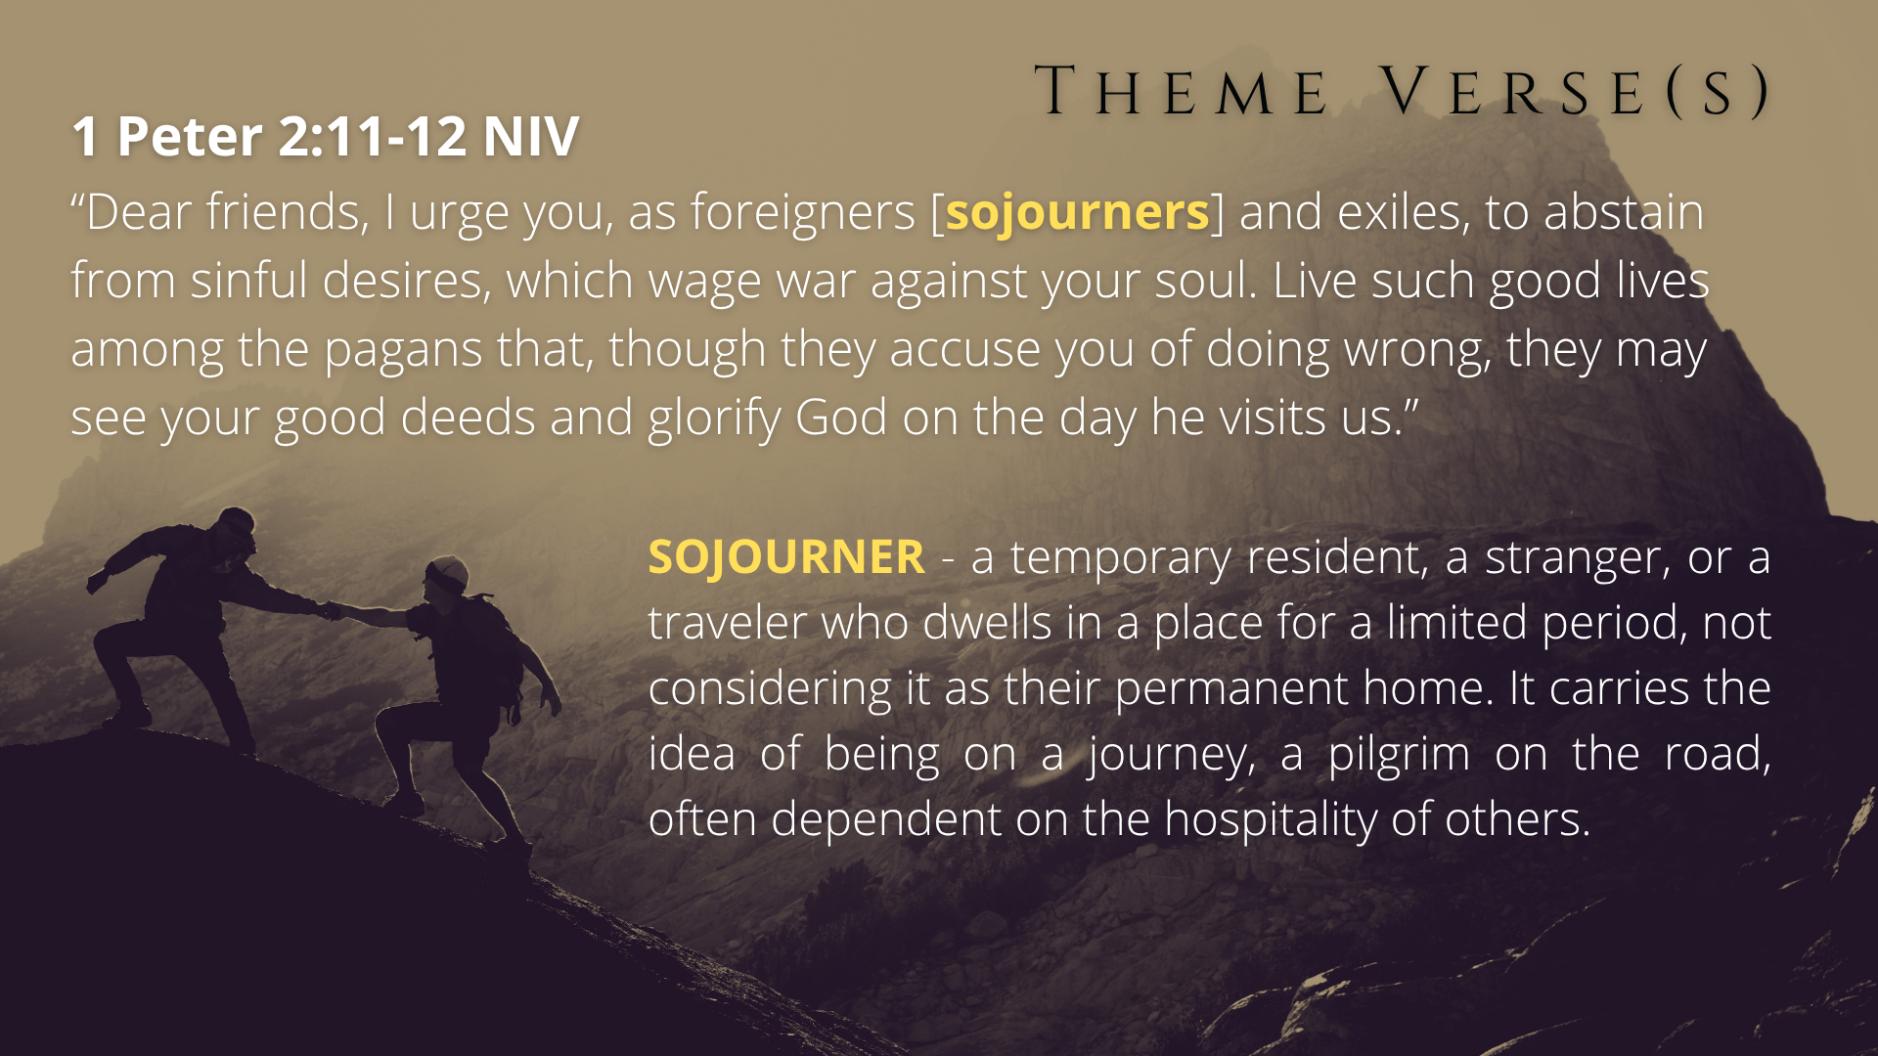
Notes:
“Dear friends, I urge you, as foreigners [sojourners] and exiles, to abstain from sinful desires, which wage war against your soul. Live such good lives among the pagans that, though they accuse you of doing wrong, they may see your good deeds and glorify God on the day he visits us.”
So, in a world that often feels like it’s not our home, how do we live with courage, integrity, and purpose as disciples of Jesus? The Apostle Peter helps us with that in his first letter.
If you’re just joining us today, or you’re helped by a brief review, here is what we’ve covered so far in our verse-by-verse study of 1 Peter… [NEXT SLIDE]

Slide 3
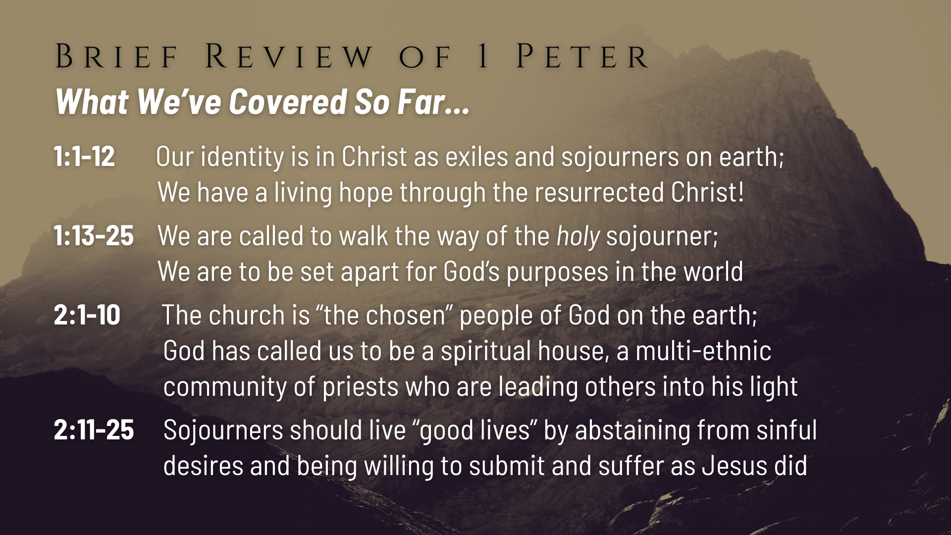
Notes:
Peter began his letter by reminding these believers that their identity is not to be found in the world but in Christ, who has given us a “new birth into a living hope through the resurrection of Jesus Christ from the dead.” It’s because of this new identity in Christ and belief in God’s good future that we can follow Jesus and live faithfully in exile.
And then we heard Peter invite us to walk the way of the holy sojourner. We are to be holy as God is holy, i.e., we are to be full of light, love, and the life of God. We’re called to become like the God revealed in Jesus and be set apart for his purposes in the world, as we love God and one another deeply from the heart.
And then in chapter 2, we heard Peter use old covenant language about Israel and apply it to God’s new covenant people, the Church. Peter, a Jewish apostle, says that we (Jew & Gentile followers of Jesus) are ”the chosen” people of God on the earth. We are called to be a ”holy nation”, a spiritual house, and a multi-ethnic community of priests who are leading others into his wonderful light. And we are to do that wherever God has placed us in this world. We are to be sojourners living ”good lives” by abstaining from sin and submitting to Jesus.
In chapter 3… [NEXT SLIDE]

Slide 4
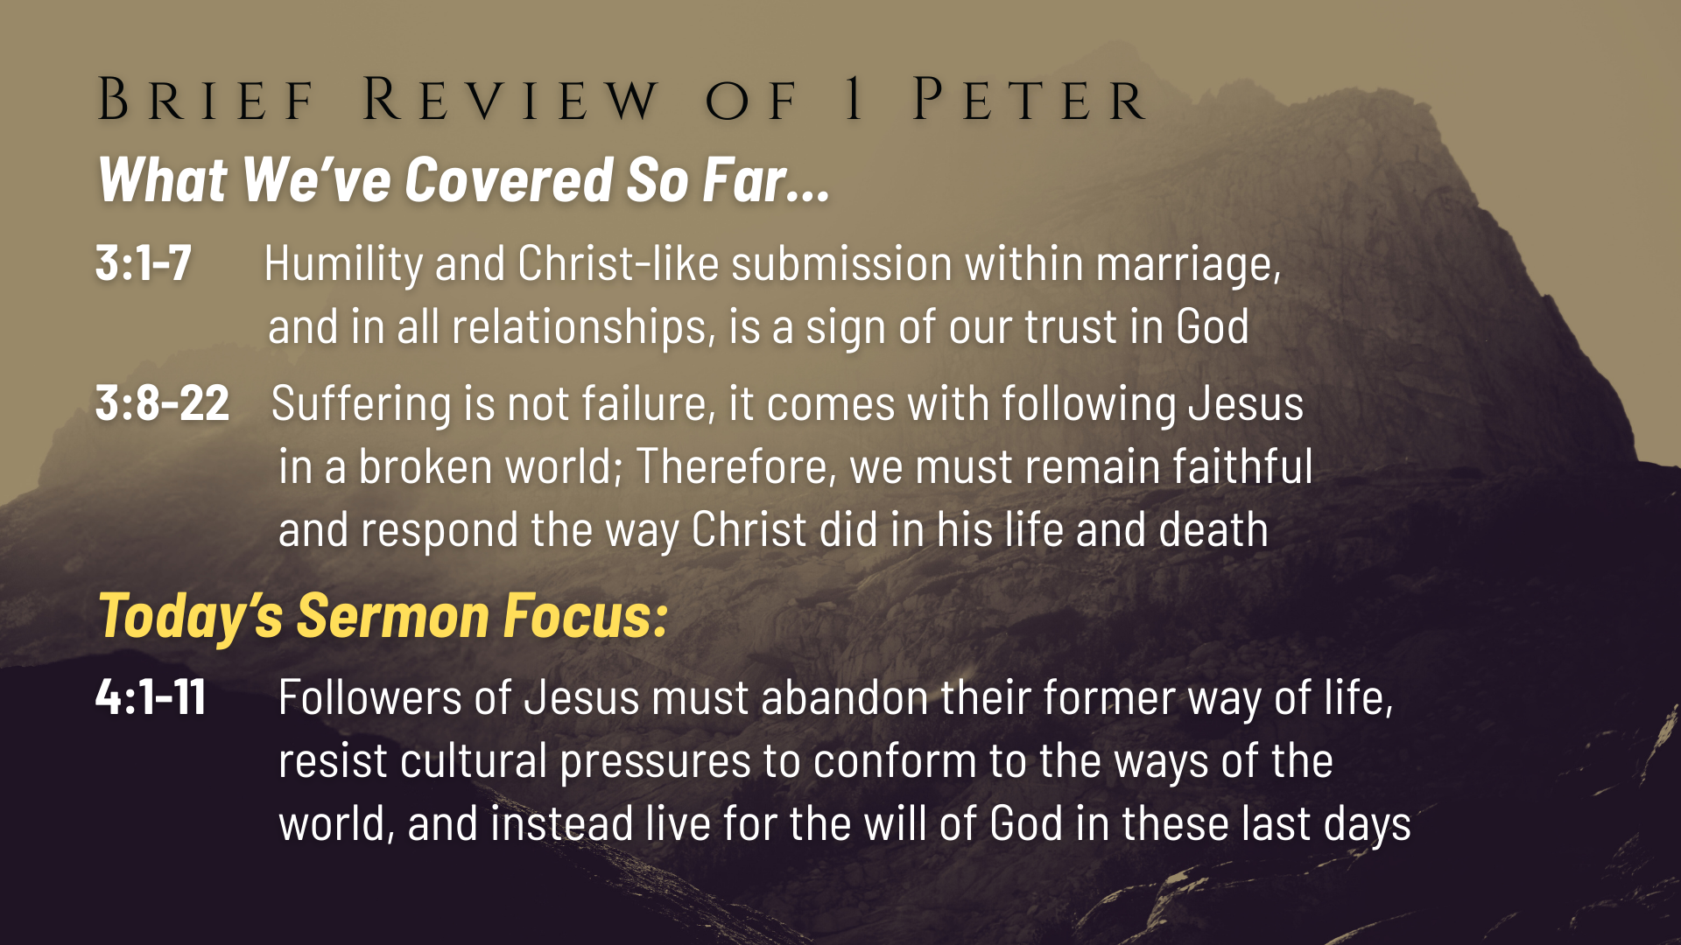
Notes:
Peter applies his message to the family or the ”household”, particularly to wives and husbands, but also to slaves and those who find themselves under the authority and power of an unbeliever. Peter says we should be humble and “submit” in the way Christ did when he suffered injustice from those who didn’t understand or accept his gospel. In doing that, we reveal our trust in God and our belief in the power of the cross to change hearts and minds.
And then as we heard last week, we should prepare ourselves for suffering and know that suffering does not necessarily indicate a failure on our part (often it doesn’t), but, rather, it comes with following Jesus in a broken, fallen world. It is to be expected. And when it comes, we must remain faithful and respond the way Christ did in his life and death. So, like Jesus, we can trust that God will use it for our good and his glory if we will persevere.
That brings us to today’s focus in chapter 4 verses 1-11. This morning we’re going to hear Peter call Jesus followers to fully abandon our former way of life, resist cultural pressures (particularly the sin and vices of the place in which we live), so that we might instead live for the will of God. And that’s what this sermon, message 7 of 9, is entitled… [NEXT SLIDE]

Slide 5
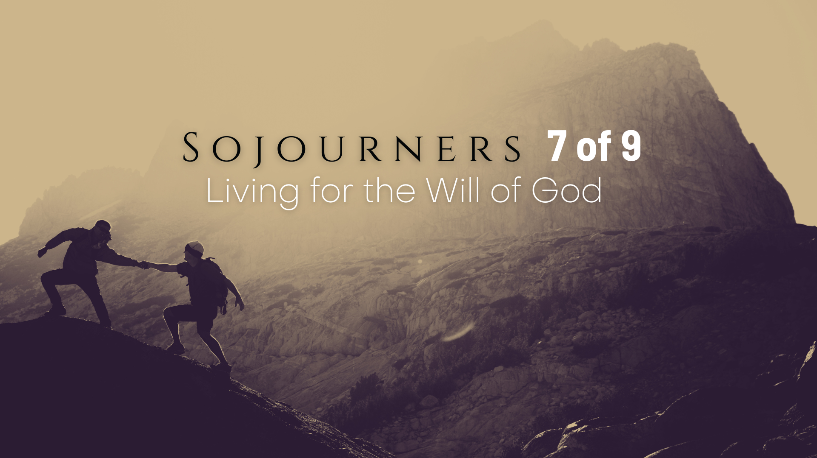
Notes:
Living for the Will of God.
But before we start reading verse-by-verse and unpacking the Scriptures together, let’s pray and prepare our hearts to receive a word from the Lord.
[BRIEF PRAYER]
Please open your Bibles or your Bible app to… [NEXT SLIDE]

Slide 6

Notes:
1 Peter chapter 4, beginning with verse 1.
v. 1a – recall vs. 3:17-18; “arm yourselves” (take up arms) with a specific attitude or mindset—the same mindset of Christ; faithfulness to Christ may lead to suffering
v.1b – difficult wording, but the pastor and scholar Dennis Edwards believes that Peter appears to be saying “that those who have suffered on account of their faith are the same people who have already renounced sinful behavior and therefore are “done” with sin.” Think about it. If you’re willing to suffer for what is right and good, then sin is no longer your master because you don’t back down in the face of hardship. A willingness to suffer and endure it for Christ means that obedience has become for you greater than comfort.
v. 2 – so, the result of being “done with sin” is not about being sinless; it’s about a change in the orientation of your heart—you don’t live for yourself and “evil human desires” (passions) any longer because your center of gravity has shifted—you now live for “the will of God.”
What is the will of God? Well, there is a lot that could be said here, but I’ll sum it up like this… [NEXT SLIDE]

Slide 7
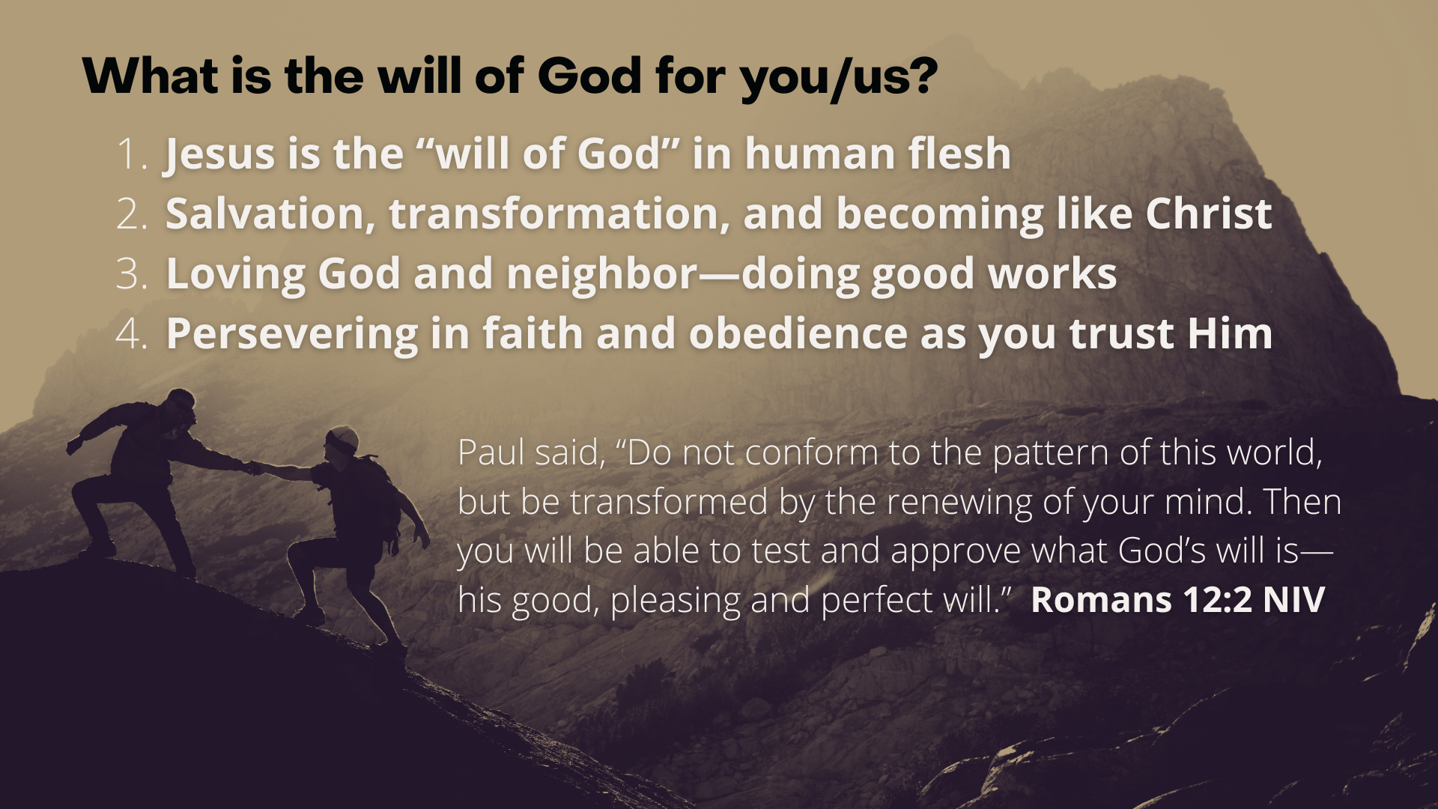
Notes:
[READ SLIDE & COMMENT]
Unsure about God’s will? Then know this: Jesus sets the boundaries of God's will. If it doesn't look like Christ, then it's outside the will of God. Jesus is the will of God for us.
Eph 1:5, 9 – God’s will is that we be adopted as His children through Jesus Christ and brought into His redemptive plan; 2 Pet 3:9 – God desires that no one perish
Eph 2:10 – We are created in Christ to do good works, which God prepared in advance for us to do; and as Peter has already said (3:17), it can be God’s will to suffer for doing good
Heb 10:36 – “You need to persevere so that when you have done the will of God, you will receive what he has promised.”
When it comes to discerning the will of God, we tend to focus on destination kinds of questions (e.g., what decision do I make (school, job, marriage, etc.) … where or what direction do you want me to go?). While those are important questions, and it’s certainly advisable that you seek God’s will in those decisions, please hear this… God is far more interested in who you’re becoming rather than where you are going. In other words, God is first and foremost concerned about your spiritual formation rather than your earthly destination. Because even if you got to where you need or want to go, what difference does it make if you’re not who Jesus wants you to be as a human being when you get there.
Back to 1 Peter 4, verse 3… [NEXT SLIDE]

Slide 8
Notes:
v. 3 – ”debauchery” (sensuality, unbridled lusts, & excesses of various kinds) - setting the tone for a list of hedonistic sins; “lust” (sexual desires and passions); ”drunkenness” (of course, alcohol in itself is not sinful, it’s the misuse of it that Scripture condemns; that’s because drunkenness dulls the mind, lowers moral restraint, and disrupts fellowship with God and others; In Gal 5:19-21, drunkenness is listed among the “works of the flesh” that can keep one from inheriting the kingdom of God. That’s why in Eph 5:18, Paul says, “Do not get drunk on wine, which leads to debauchery. Instead, be filled with the Spirit.” Back to Peter’s list… “orgies” (likely related to pagan festivals involving heavy drinking); “carousing” (parties); “detestable (or lawless) idolatry” the end result of the sins listed here.
v. 4-5 – The decision not to engage in what is normal in secular society seems odd; self-restraint seems strange to their pagan neighbors, and so they are denigrated for it; But Peter reminds us that God is watching them, and their deeds are being written down in heaven.
v. 6 – “those who are now dead” – believers who have died prior to Peter’s letter
This should remind us of what the Apostle Paul wrote in Galatians 5:16… [NEXT SLIDE]

Slide 9
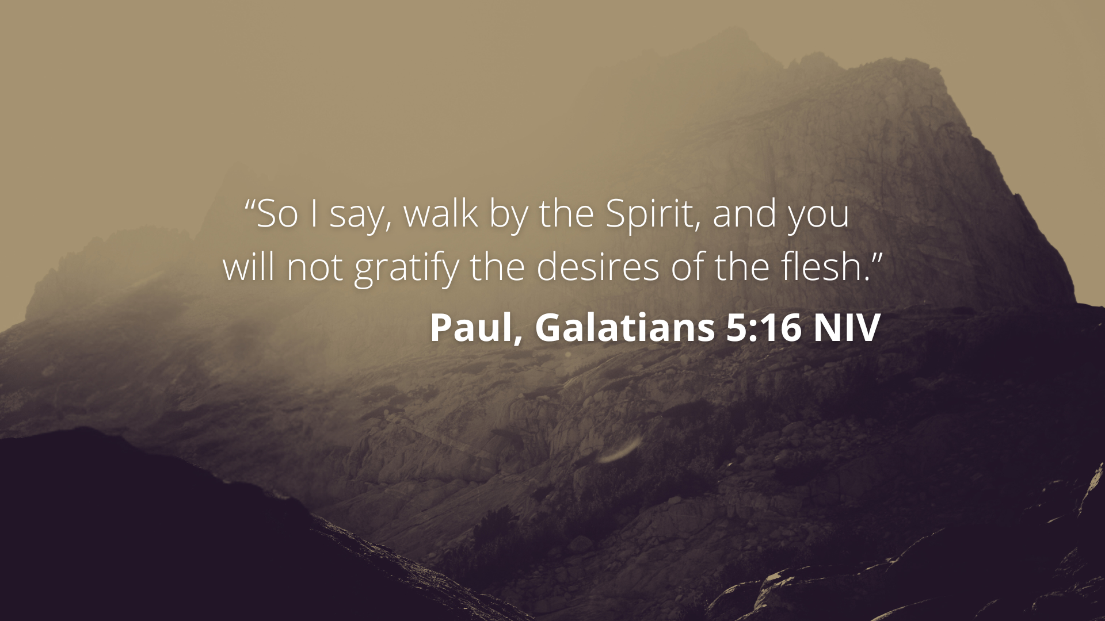
Notes:
[READ VERSE & COMMENT]
The NT frequently contrasts flesh and Spirit, i.e., am I going to follow my own sinful inclinations, passions, and desires… or will I deny myself and walk in the Spirit of Christ?
And I think if we’re going to walk in the Spirit and be set apart as Peter is calling his original audience (as well as us), then we need to be honest with ourselves, because for many of us we too often accept the things of the world with little to no discernment about whether it is something that is good for us or something that we should go along with as Christians.
I’m sure we all do this to an extent. And so, we must be mindful of it (the moral compromises and the secret indulgences), lest we be seduced by the world and what it offers. That’s why John said this… [NEXT SLIDE]

Slide 10
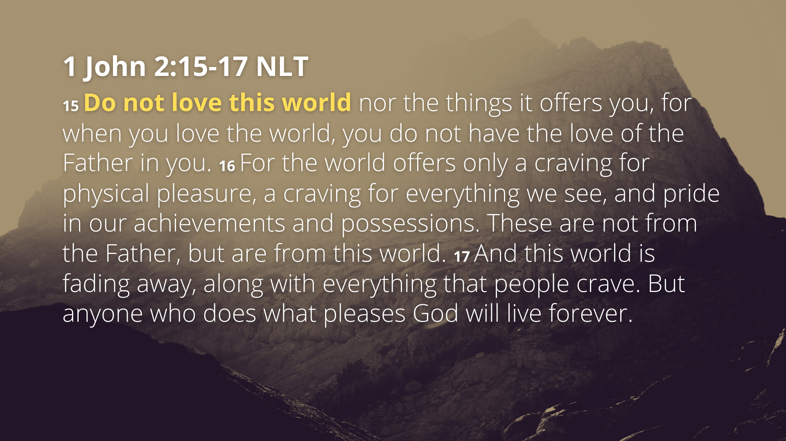
Notes:
[READ PASSAGE & COMMENT]
v. 17b - NLT: “what pleases God” – NIV: “does the will of God”
Now back to 1 Peter 4, verse 7… [NEXT SLIDE]

Slide 11
Notes:
v. 7 – “the end of all things is near” - notice how eschatology informs Peter’s thinking; his belief that we’re living in the last days creates a sense of urgency and heightened awareness; “be alert” (self-controlled) and “of sober mind” (clear-headed); keep your head on straight, stay in the spiritual game, see things for what they really are, don’t lose the plot or forget who you are and why you’re here; keep a gospel mindset about you and see the world as a spiritual battle that ends with Jesus and his church victorious, so you can pray!
v. 8 – “love each other deeply” – not just with words but with actions, because intense love within the Body of Christ helps to cultivate unity when people are fearful and frustrated because of what’s happening in the world; when there are outside forces threatening, the panic and alarm tends to go up, and Peter is saying that is when you must dig your heels in (not run), stay, pray, and love, because that’s the only way to forgive and protect the church.
Verse 9… [NEXT SLIDE]

Slide 12
Notes:
v. 9 – “offer hospitality” (be generous with others); Why? Because what is the typical impulse when there is uncertainty, fear, suffering, etc., we are tempted to turn inward and think only of ourselves; But Peter says, don’t do that. Resist the forces that seek to enslave you by intentionally being generous and hospitable to guests and strangers.
v. 10 – “use whatever gift you have received to serve others” is a tangible way that we can put our love into action; Our “gifts” are God’s grace to us and to the community; so, exercise and manifest God’s love and grace to bless God’s people and further the mission.
v. 11 – Notice, Peter is inviting us to see the exercise and administration of our gifts, whether they be shared through speech or actions, as divinely given and empowered. In other words, whatever you have to give is of divine importance; it’s no small matter.
Again, in the face of opposition, challenges, and suffering, we hear within the NT how particularly important our commitment to Christ and his church is for our efforts to remain faithful in our beliefs and behavior as Jesus followers. Listen to what the author of Hebrews writes in chapter 10, verses 23-25… [NEXT SLIDE]

Slide 13
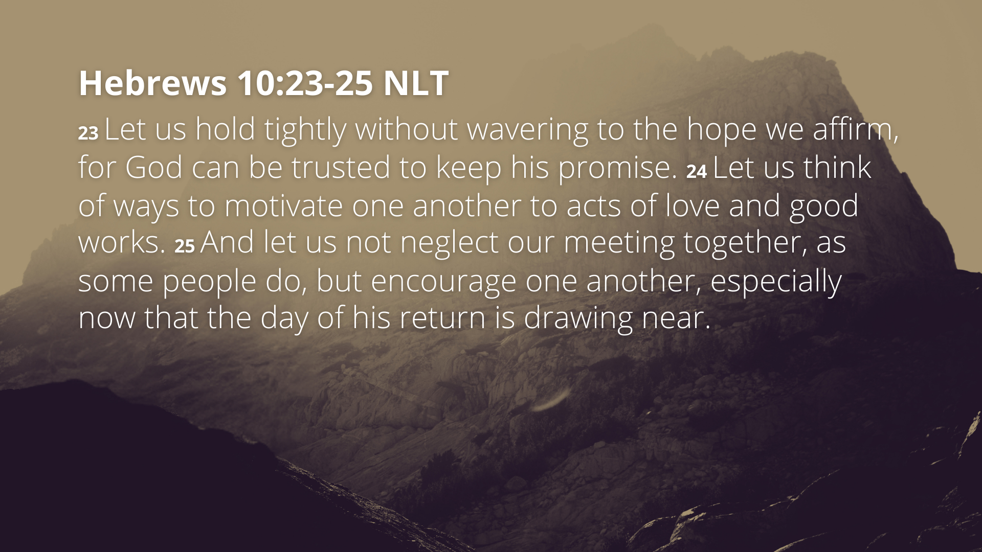
Notes:
[READ PASSAGE & COMMENT]
Let’s sum up what we’ve read in 1 Peter 4:1-11 today. Here are some takeaways and application based on what we’ve covered in this message… [NEXT SLIDE]

Slide 14
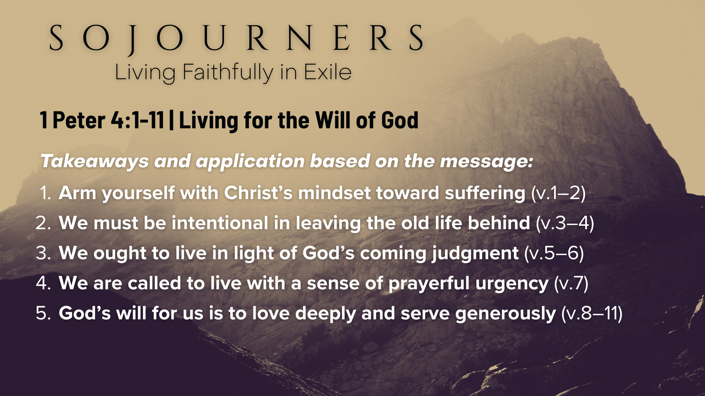
Notes:
Arm yourself with Christ’s mindset toward suffering (v.1–2) Believers must choose to live for God’s will rather than human desires, even if it brings hardship. Suffering can serve as a refining moment that deepens spiritual resolve.
We must be intentional in leaving the old life behind (v.3–4) Christians must resist pressure to conform to past patterns, being willing to stand apart—even if it means social alienation—because we now live for Christ.
We ought to live in light of God’s coming judgment (v.5–6) Knowing that all will give an account to God should encourage us to remain faithful and to proclaim the gospel in word and deed with a sense of urgency.
We are called to live with a sense of prayerful urgency (v.7) True Christians will cultivate a prayer life marked by watchfulness, clarity, and purpose, not spiritual distraction, cynicism, or indifference. Our prayers matter.
God’s will for us is to love deeply and serve generously (v.8–11) Believers should practice forgiving love, open-hearted hospitality, and faithful stewardship of their God-given gifts, aiming to glorify God in everything we do.
Finally, here are some questions to help us reflect and respond together… [NEXT SLIDE]

Slide 15
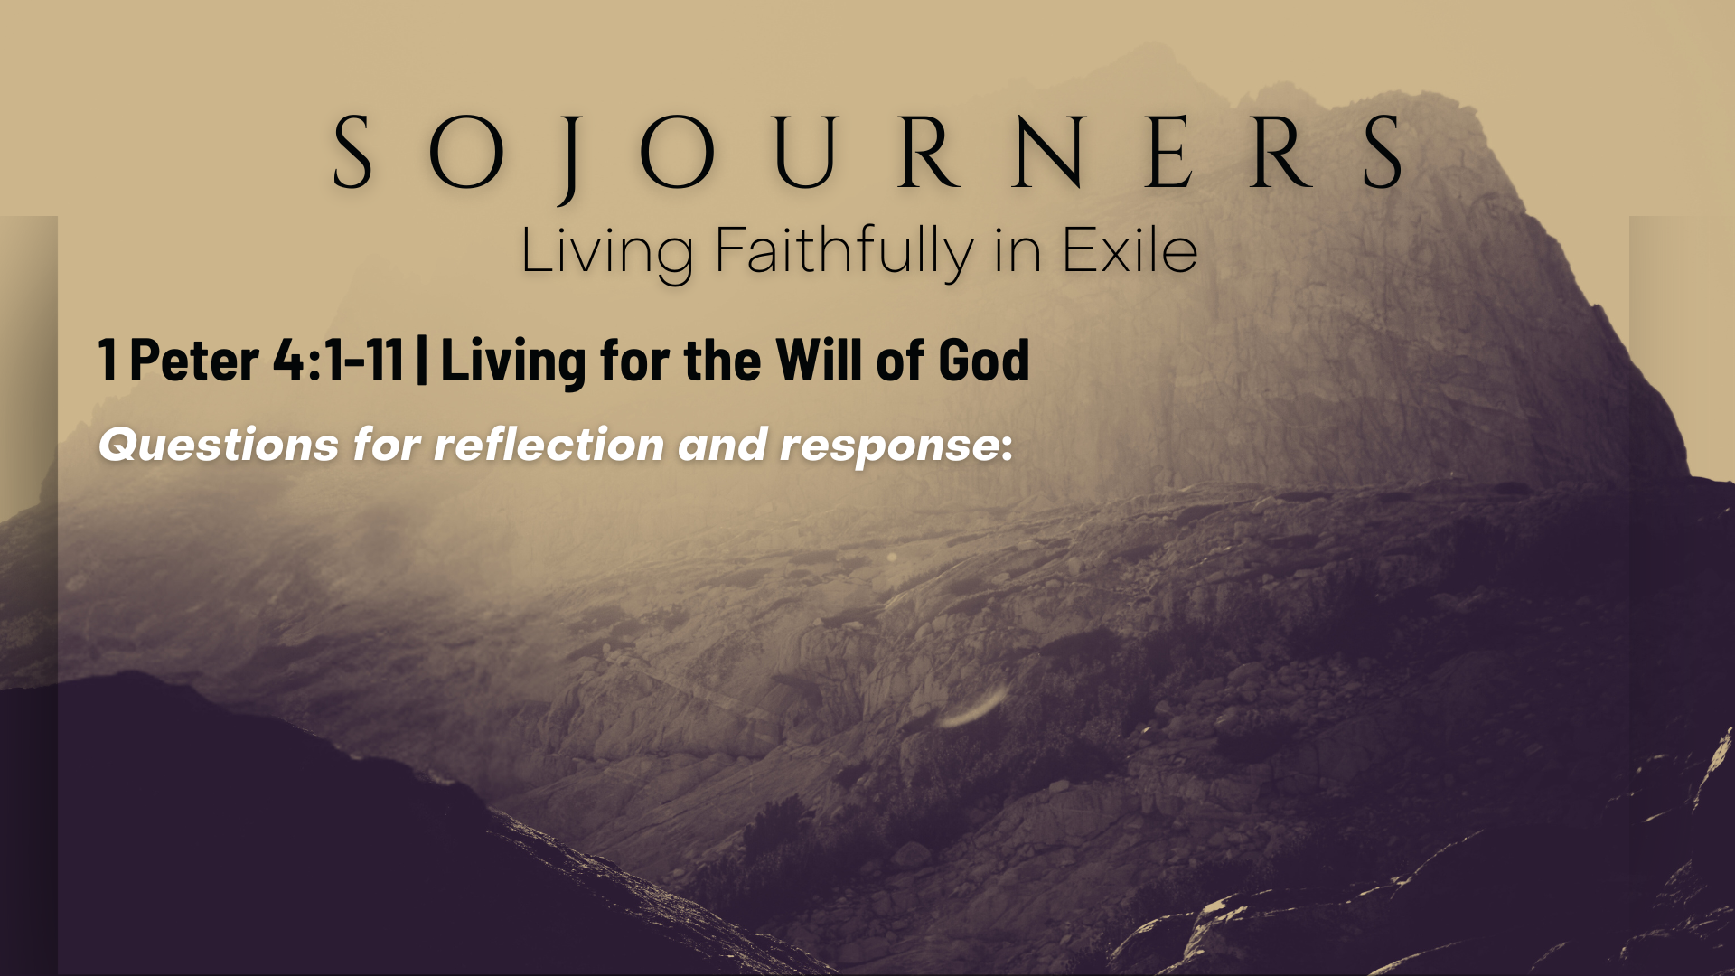

Slide 16
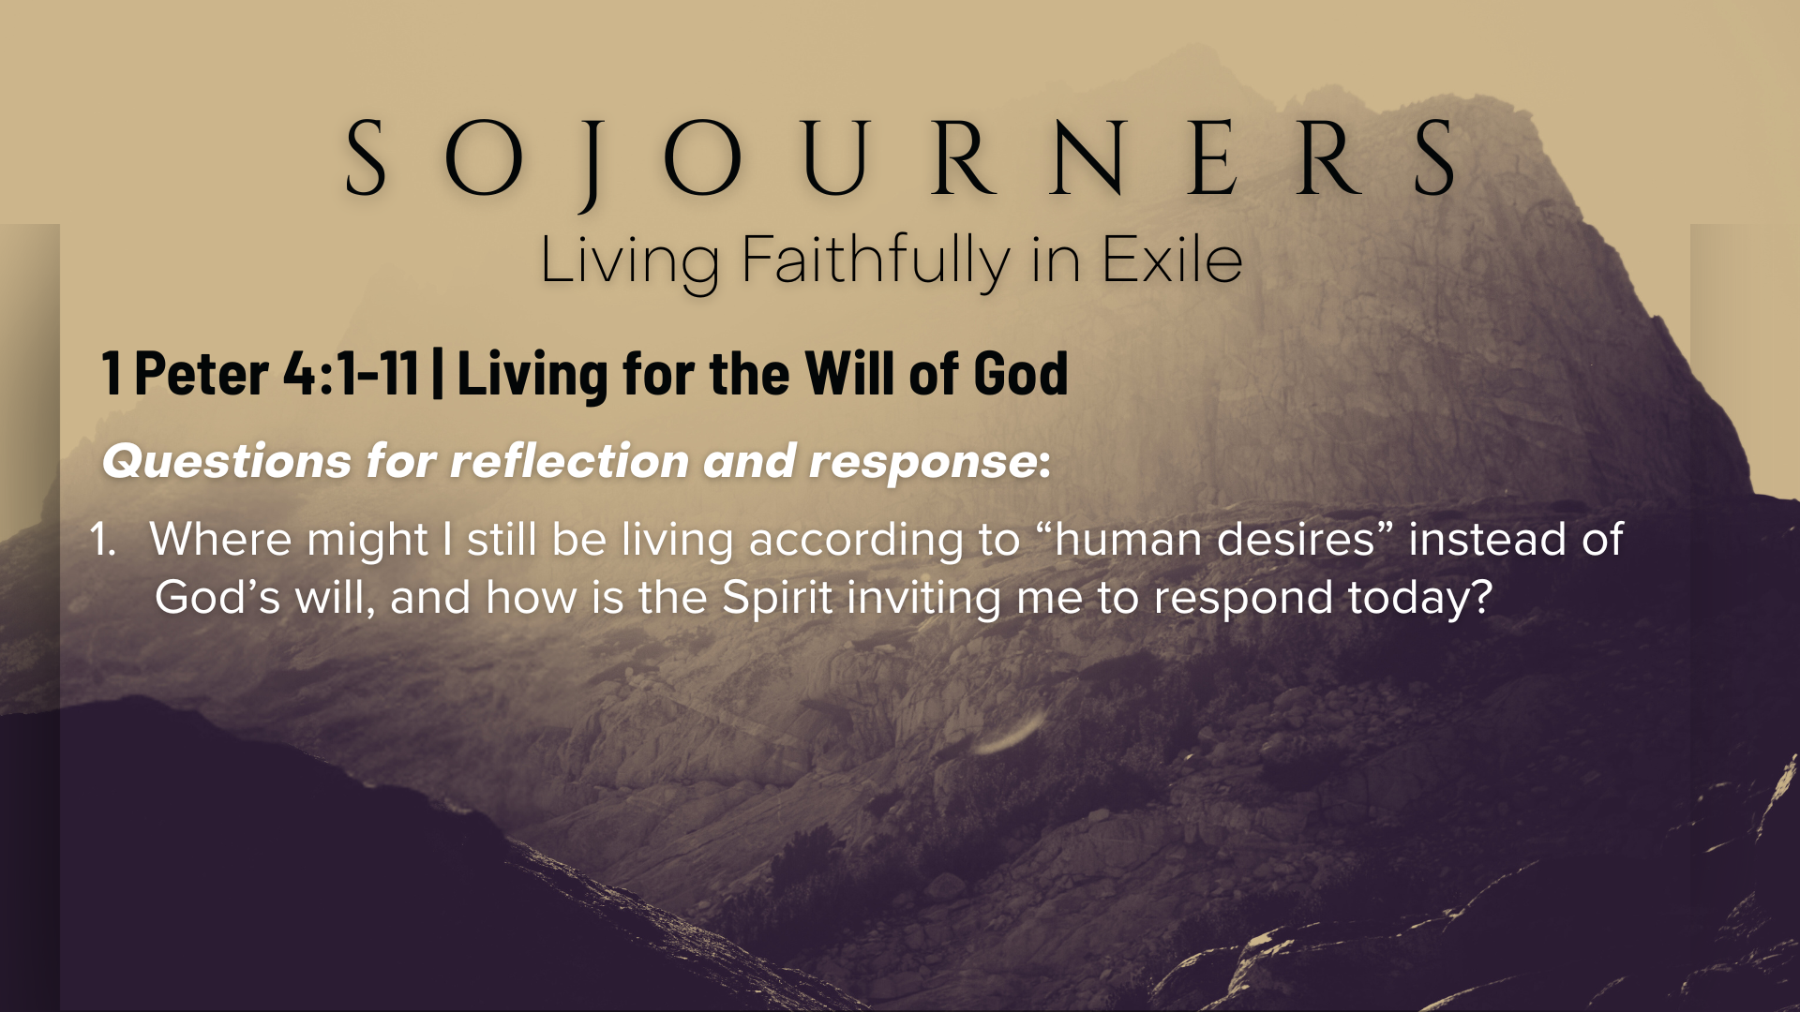

Slide 17
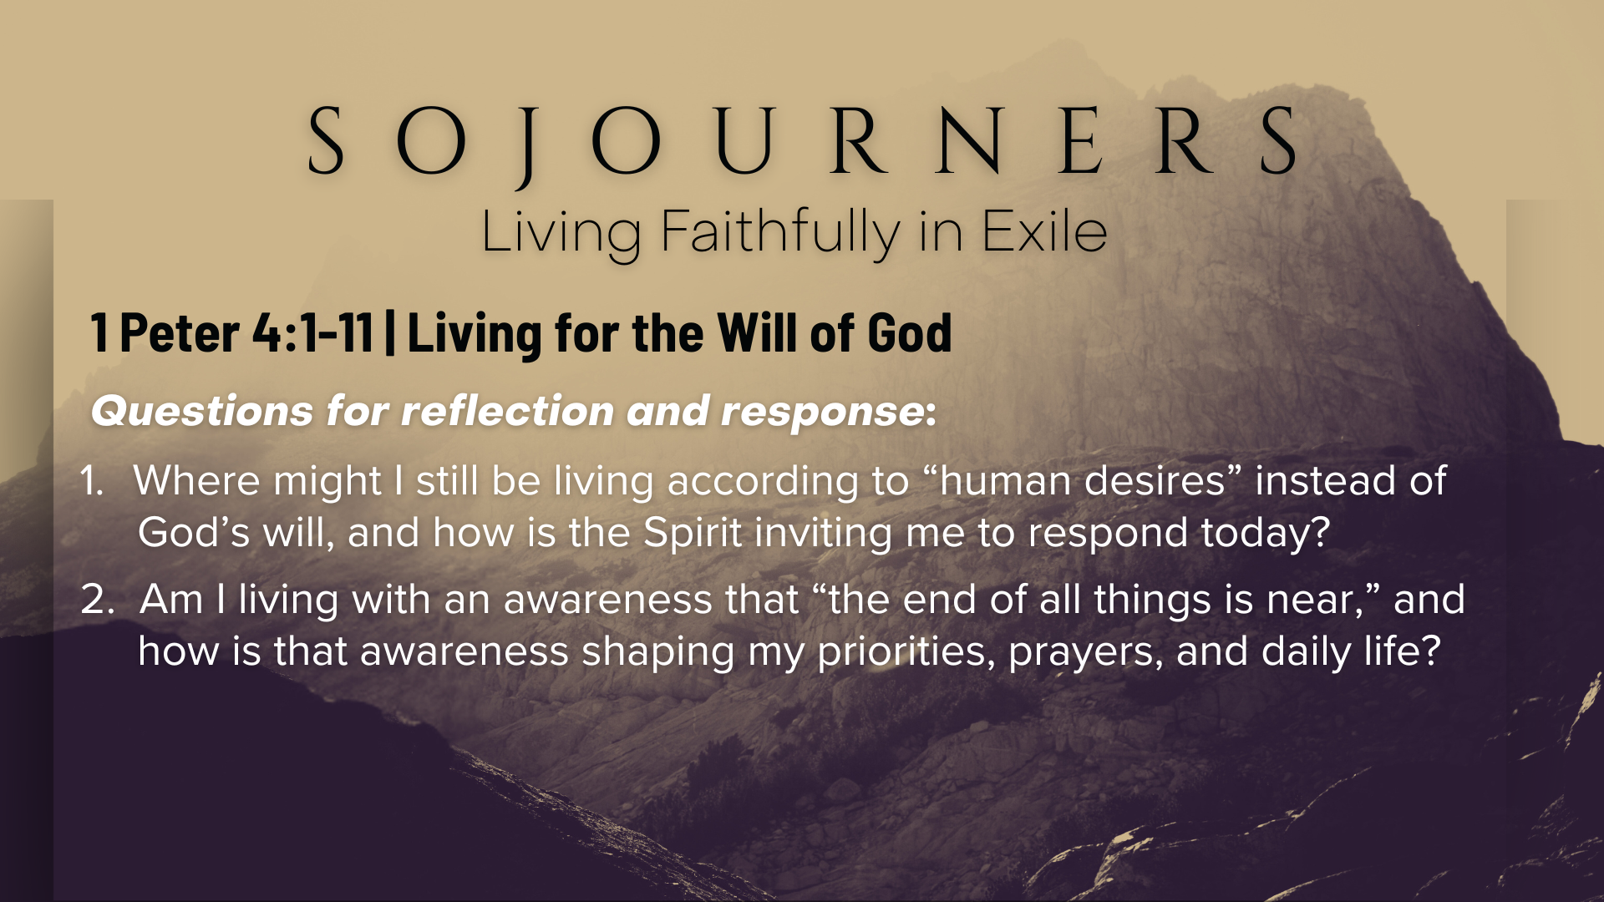

Slide 18
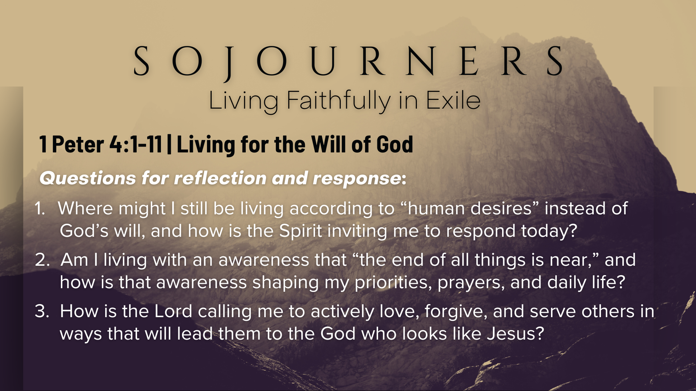
Notes:
[READ & BRIEF COMMENT ON EACH QUESTION]
Where might I still be living according to “human desires” instead of God’s will, and how is the Spirit inviting me to respond today?
Am I living with an awareness that “the end of all things is near,” and how is that awareness shaping my priorities, prayers, and daily life?
How is the Lord calling me to actively love, forgive, and serve others in ways that will lead them to the God who looks like Jesus?
[CLOSING WORDS]
Let’s pray… [NEXT SLIDE FOR CLOSING PRAYER]

Slide 19
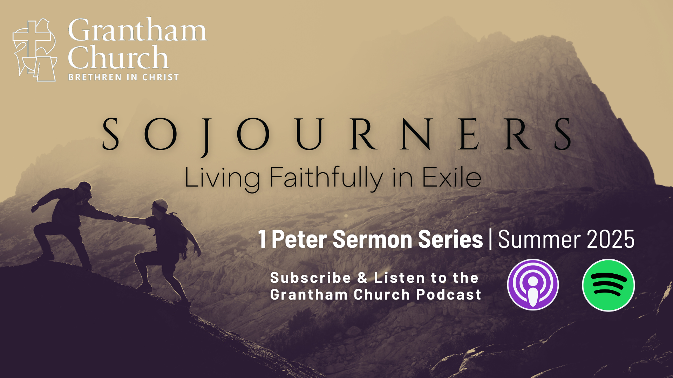
Notes:
[CLOSING PRAYER]
Benediction
Chosen people of God, as sojourners and exiles in this world,
set your hearts on the Living Hope – Christ risen and reigning.
As you go into the world,
may you walk in hope,
stand firm in God’s grace,
shine with the love of Jesus,
and allow the Spirit to sustain you in all things,
until the day your sojourning gives way to glory.
Go in peace, church,
and live faithfully in exile.
Amen.

